Slide 1

RAJESHWARI VEDHACHALAM ARTS & SCIENCE COLLEGE
INTELLIGENT ADMISSION:THE FUTURE OF UNIVERSITY DECISION MAKING WITH MACHINE LEARNING
Presented by
Guided by
HEMASRI.S
SIVARANJINI.E
JAYABHARATHI.B
ARCHANA.S
DR.T.VANI
PROF.K.S.SURESH
PG DEPARTMENT OF COMPUTER SCIENCE
April-2023

Slide 2
Content
01
Abstract
02
Introduction
03
Objectives
04
Literature Review
05
Methodology
06
Exploratory Analysis
07
Model Design
08
Data Analysis
09
Future Scope
10
Conclusion
THE FUTURE OF UNIVERSITY DECISION MAKING WITH MACHINE LEARNING
April-2023
2

Slide 3
1. Abstract
This project explores different university choice models that analyze the student behavior in the higher education Institute and suggests a new one.
considering the phases of the decision making process and the factors that influence university choice decision.
Finally, implication of factors in different phases of the decision process are discussed.
THE FUTURE OF UNIVERSITY DECISION MAKING WITH MACHINE LEARNING
3
April-2023

Slide 4
2. Introduction
University admission is a process by which students are selected to attend a college or university
why This project:
The main Aim is to help students in shortlisting the universities with their profiles.
Suggested solutions to problems:
By being well-informed, prepared and organized students can increase their chances of admitted of university to their choice.
THE FUTURE OF UNIVERSITY DECISION MAKING WITH MACHINE LEARNING
April-2023
4

Slide 5
3. Objectives
A project aims to predict the chances of student getting admitted to a particular university based on certain factors
This project is that it will help students make more informed decision about which universities to apply to.
Also help universities councellors to better advise on students on the universities they are most likely to be admitted to the university.
THE FUTURE OF UNIVERSITY DECISION MAKING WITH MACHINE LEARNING
April-2023
5

Slide 6

4.Literature review
Sr. No. | Author | Title | Source | Findings/Remark
1 | JOSE et al (2006) | International student decision making process | International journal of education management | To tackle the decision making process from an integrated point of view. this paper contributing to bridging that gap.
2 | SANAZ et al (2015) | Revising student decision making process | Research gate | This paper attempts to provide guidance for further investigation in the decision making process.
3 | HAYFA et al(2021) | Understanding the decision making process of college | Community college journal of research and practice | The findings revealed that college students rely heavily on recruitement agents,friends and relatives in their decision making process.
THE FUTURE OF UNIVERSITY DECISION MAKING WITH MACHINE LEARNING
6
April-2023

Slide 7
5. Methodology
DEFINING PROBLEM
DATA COLLECTION & PREPARATI0N
EXPLORATORY DATA ANALYSIS
MODEL BUILDING
BUSINESS PROBLEM
BUISNESS REQUIREMENTS
LITERATURE SURVEY
SOCIAL OR BUISNESS IMPACT
COLLECTING THE DATA SET
PREPAING THE DATA SET
DESCRIPTIVE STATISTICAL
VISUAL ANALYSIS
UNIVARIATE
BIVARIATE
PAIR PLOT
SCATTER PLOT
SUB PLOT
TRAINING THE MODEL IN MULTIPLE ALGORITHM
TESTING THE MODEL
LOGISTIC REGRESSION
ANN MODEL
THE FUTURE OF UNIVERSITY DECISION MAKING WITH MACHINE LEARNING
7
April-2023

Slide 8
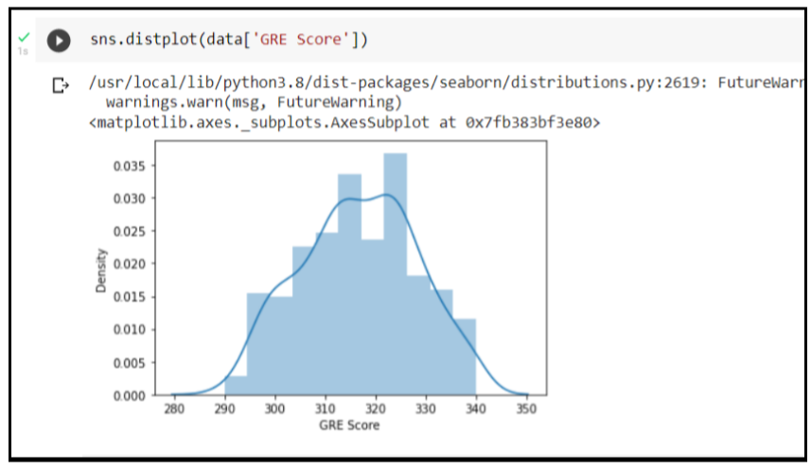
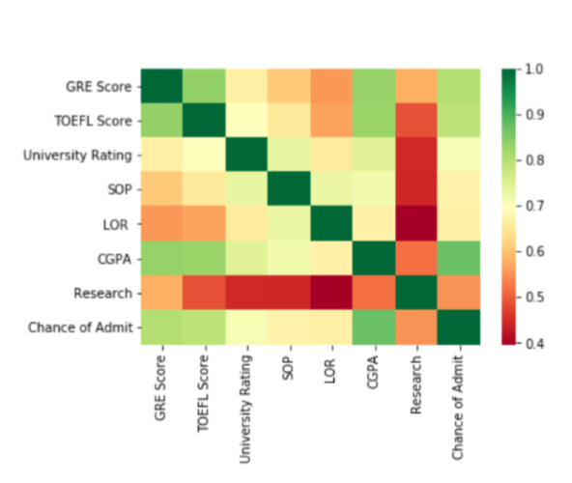
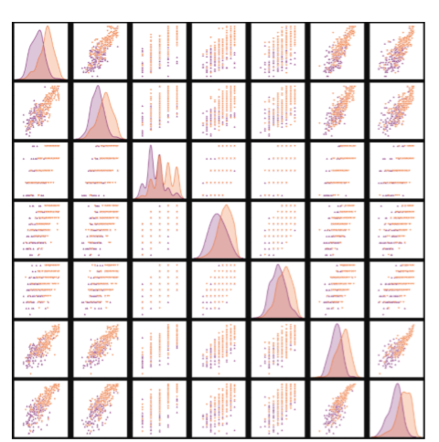
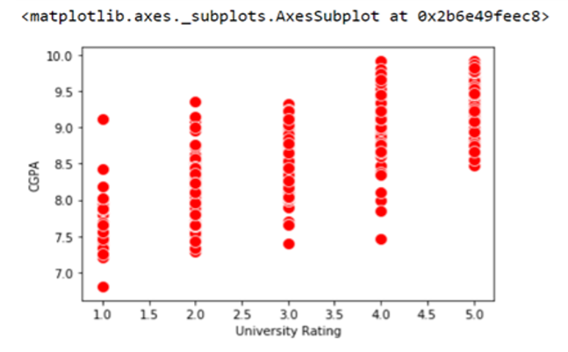
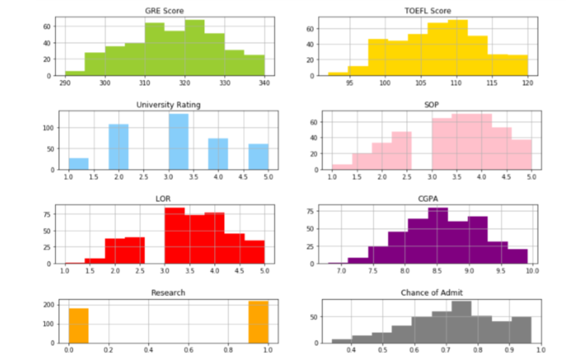
6.EXPLORATORY ANALYSIS
PAIR PLOT
UNIVARIATE ANALYSIS
BIVARIATE ANALYSIS
SCATTER PLOT
SUBPLOT
THE FUTURE OF UNIVERSITY DECISION MAKING WITH MACHINE LEARNING
8
April-2023

Slide 9
7.MODEL DESIGN
ANN MODEL
Building and training an Artificial Neural Network (ANN) using the Keras library with
TensorFlow as the backend.
The input layer and two hidden layers are added to the model using the Dense class.
The model is then compiled with the Adam optimizer, binary cross-entropy loss function, and accuracy metric.
Finally, the model is fit to the training data with a batch size of 100, 20% validation split, and 100 epochs.
with accuracy: 0.7589
THE FUTURE OF UNIVERSITY DECISION MAKING WITH MACHINE LEARNING
9
April-2023

Slide 10

8. Data analysis
In this project we have used certain process of data collection method and analysis to get the predicted results.
Here the outcomes are represented using various forms such as charts,graphs and plots etc.
Descriptive statistical
we have studied the basic features of data with statistical process and found results for the continous features such as
GRE score
TOEFL score
SOP
LOR
University rating
Chance of admit&
Research
THE FUTURE OF UNIVERSITY DECISION MAKING WITH MACHINE LEARNING
10
April-2023

Slide 11
Data analysis
VISUAL ANALYSIS
UNIVARIATE ANALYSIS
Displot
BIVARIATE ANALYSIS
Pair plot
Scatter plot
Sub plot
By these methods we have made the analysis by including the observed data and made records according to the outcomes.
THE FUTURE OF UNIVERSITY DECISION MAKING WITH MACHINE LEARNING
11
April-2023

Slide 12

The proposed changes will reflect in the way we evaluate public,private, and higher education institution.
Help implement a student–focused framework that will bridge the gap between regional and sub locate institutions.
These tools will be used to serve general human interest to promote diversity in the social and cultural domains
THE FUTURE OF UNIVERSITY DECISION MAKING WITH MACHINE LEARNING
April-2023
12

Slide 13

10.Conclusion
University admission is the process by which students are selected to attend a college or university.
The aim of this project is to help students in short listing universities with their profiles.
With this project, students can make more informed decisions about which universities to apply to.
The universities can make more efficient use of their resources by focusing on the most promising applicants.
We have developed machine learning model using python programming language And the reports are documented.
THE FUTURE OF UNIVERSITY DECISION MAKING WITH MACHINE LEARNING
13
April-2023

Slide 14


